Slide 1
Priority Queue
Queue
Enque an item
Item returned in FIFO process
Priority Queue
Enque a pair <item, priority>
Item returned has the highest priority.

Slide 2
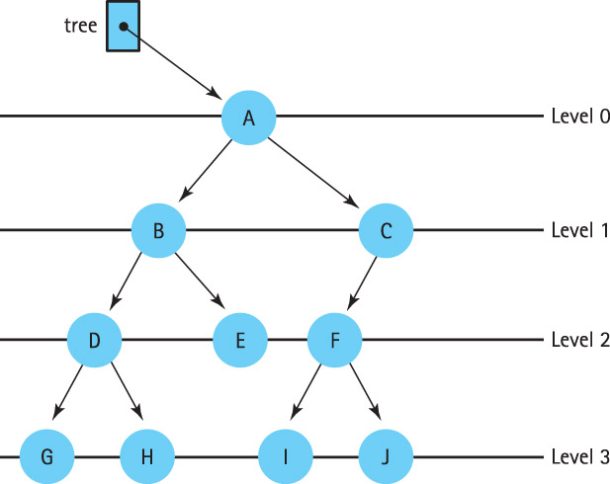

Slide 3
What is a Heap?
A heap is a binary tree that satisfies these
special SHAPE and ORDER properties:
  Its shape must be a complete binary tree.
  For each node in the heap, the value stored in that node is greater than or equal to the value in each of its children.

Slide 4
Are these Both Heaps?
treePtr
C
50
A
T
20
30
18
10
Notes:
No. Left, parent isn’t greater than all its children

Slide 5
Is this a Heap?
tree
70
60
12
40
30
8
10

Slide 6
Where is the Largest Element in a Max-Heap Always Found?
tree
70
60
12
40
30
8

Slide 7
We Can Number the Nodes
Left to Right by Level This Way
tree
70
0
60
1
12
2
40
3
30
4
8
5

Slide 8
And use the Numbers as Array Indexes to Store the Trees
tree.nodes
[ 0 ]
[ 1 ]
[ 2 ]
[ 3 ]
[ 4 ]
[ 5 ]
[ 6 ]
70
60
12
40
30
8
tree
70
0
60
1
12
2
40
3
30
4
8
5

Slide 9
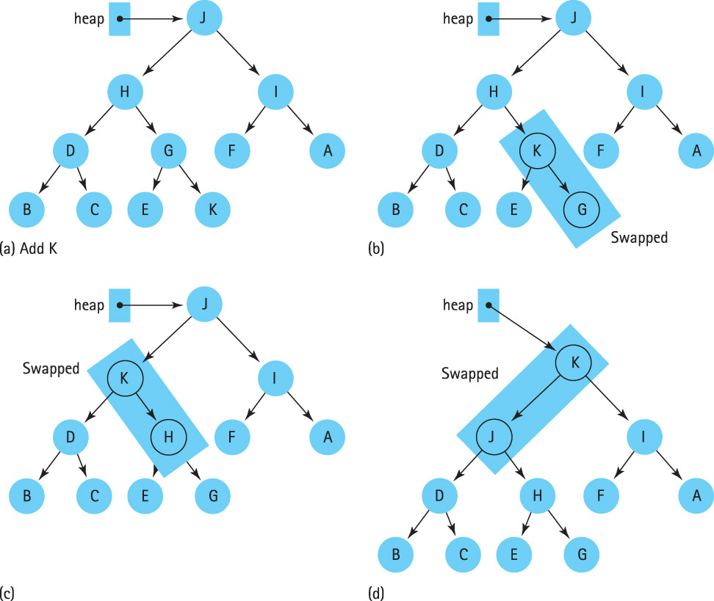

Slide 10
Priority Queue
A priority queue is an ADT with the property that only the highest-priority element can be accessed at any time.

Slide 11
ADT Priority Queue Operations
Transformers
  MakeEmpty
  Enqueue
  Dequeue
Observers
  IsEmpty
  IsFull
change state
observe state

Slide 12
// A class for Min Heap
class MinHeap
{
int *heaparray; // pointer to array of elements in heap
int capacity; // maximum possible size of min heap
int heap_size; // Current number of elements in min heap
public:
// Constructor
MinHeap(int capacity);
// to heapify a subtree with root at given index
void MinHeapify(int );
// to get index of parent of node at index i
int parent(int i) { return (i-1)/2; }
// to get index of left child of node at index i
int left(int i) { return (2*i + 1); }
// to get index of right child of node at index i
int right(int i) { return (2*i + 2); }
// to extract the root which is the minimum element
int extractMin();
// Returns the minimum key (key at root) from min heap
int getMin() { return heaparray[0]; }
// Inserts a new key 'k'
void insertKey(int k);
};

Slide 13
// Constructor: Builds a heap from a given array a[] of given size
MinHeap::MinHeap(int cap)
{
heap_size = 0;
capacity = cap;
heaparray = new int[cap];
}
// Inserts a new key 'k'
void MinHeap::insertKey(int k)
{
if (heap_size == capacity)
{
cout << "\nOverflow: Could not insertKey\n";
return;
}
// First insert the new key at the end
heap_size++;
int i = heap_size - 1;
heaparray[i] = k;
// Fix the min heap property if it is violated
while (i != 0 && heaparray[parent(i)] > heaparray[i])
{
swap(&heaparray[i], &heaparray[parent(i)]);
i = parent(i);
}
}
9-<number>

Slide 14
// Method to remove minimum element (or root) from min heap
int MinHeap::extractMin()
{
if (heap_size <= 0)
return INT_MAX;
if (heap_size == 1)
{
heap_size--;
return heaparray[0];
}
// Store the minimum value, and remove it from heap
int root = heaparray[0];
heaparray[0] = heaparray[heap_size-1];
heap_size--;
MinHeapify(0);
return root;
}
9-<number>

Slide 15
// A recursive method to heapify a subtree with root at given index
// This method assumes that the subtrees are already heapified
void MinHeap::MinHeapify(int i)
{
int l = left(i);
int r = right(i);
int smallest = i;
if (l < heap_size && heaparray[l] < heaparray[i])
smallest = l;
if (r < heap_size && heaparray[r] < heaparray[smallest])
smallest = r;
if (smallest != i)
{
swap(&heaparray[i], &heaparray[smallest]);
MinHeapify(smallest);
}
}
// A utility function to swap two elements
void swap(int *x, int *y)
{
int temp = *x;
*x = *y;
*y = temp;
}
9-<number>

